Slide 1
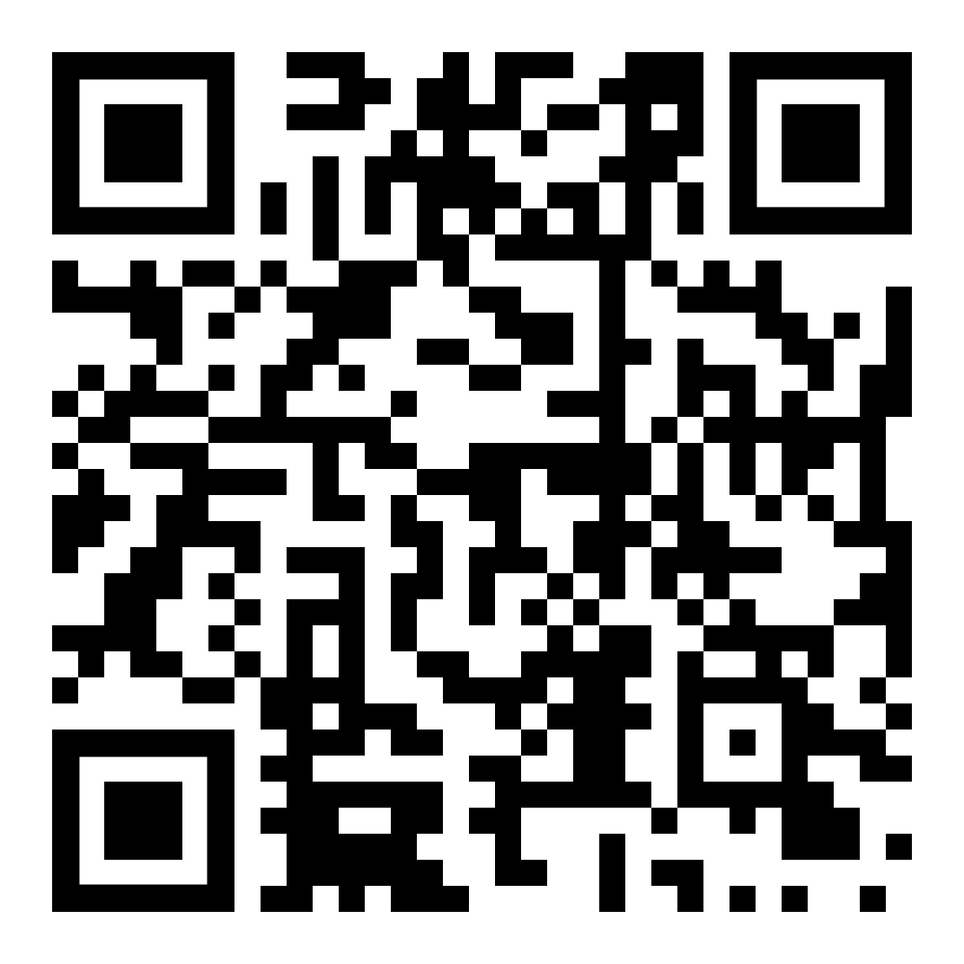
Ms. Moore
Mary E. Phillips
Financial Aid Advisor
wmoore@wcpss.net
On call Thursdays by appointment
1:00-2:30 pm.

Slide 2
WHAT WILL BE PRESENTED
l
What is Financial Aid & FAFSA?
Who can get it?
Types of Financial Aid
How much do I need?
How much can I get?
How do I apply?
What happens next?
Where can I get more info?
Notes:
Here you can briefly list the questions that will be answered during the presentation.

Slide 3
TYPES OF

Slide 4
THE FAFSA FREE APPLICATION FOR FEDERAL STUDENT AID allows college students to access financial aid for college, including grants, scholarships, work-study and federal student loans.
OPENS DECEMBER 2023 FOR 2024-2025 SCHOOL YEAR
The FAFSA opens in December 2023 for the 2024-2025 school year. It will open on October 1st in the following years. The FAFSA requires contributors to directly exchange data with the IRS. The FAFSA form has 36 questions (used to be 108), making filing quicker and easier.

Slide 5
Find out how colleges treat outside scholarships.
Find out what it takes to keep or renew a scholarship.
Need-based scholarships: determined by financial circumstances (FAFSA).
Merit-based scholarships: determined by achievement, a special talent or skill or other qualifying factor. Most colleges automatically consider students. Some colleges require the FAFSA.
Special-circumstance scholarships: determined by military service, unique interest, disability status, etc.

Slide 6
How to Research Scholarships Be patient & persevere It takes a lot of work & effort and there are no guarantees
Get organized – keep a calendar of deadlines, keep a notebook or file system
Seek help early – give your supporters plenty of time to respond, be sure to thank them
Submit early – starting early makes a favorable impression
Expand research – HS counselor, colleges, civic groups, church, employers, etc.
Follow instructions – do exactly what you are asked to do – no more, no less
Proofread – check for clarity of content, legibility, accuracy & completeness
Keep copies – hold onto a copy of everything you send & record date sent
Be wary of “no essay” scholarships or ones that don’t ask for much information – they are just like sweepstakes with companies looking to gather your information.
SCAM ALERT! Don’t ever pay a fee to apply for a scholarship.
Chances of winning a scholarship are highest when applying for locally sponsored funds
Students should start scholarship researching in their first year of high school – especially “full ride” scholarships – to prepare themselves to be the best possible applicants later.

Slide 8
North Carolina Grant Requirements
Each grant requires a unique set of applicant characteristics, so don’t overlook individual traits that open scholarship doors. Often, a series of personal attributes work in your favor, to qualify you for financial aid. Typically, grant programs fall into these categories:
Student-specific Subject-specific Degree level-sensitive Minority only
North Carolina Student Incentive Grant (NCSIG)
North Carolina Community College Grant Program
Certain Private Education Institutions Grant (CPEI)
North Carolina Legislative Tuition Grant
North Carolina Education Lottery
High-Needs Fields Lure North Carolina Students

Slide 9
Federal Supplemental Education Opportunity Grant (FSEOG)
Administered directly by the financial aid office at each participating school. Not all schools participate. The grant that is awarded to an undergraduate student who demonstrates exceptional financial need to help pay for their education. Awards can range from $100–$4000 and do not need to be repaid.
From $650 to $6,895
for the 2022–23 award year
$6,895
Maximum Amount for 2023-2024

Slide 10
Provides part-time employment while you are enrolled in school.
It’s available to students with financial need.
It’s available to full-time or part-time students.
Check with your school's financial aid office to find out if your school participates in the Federal Work-Study Program.
Apply for aid early. Funds are limited

Slide 11
Are jobs on campus or off campus? Both. If you work on campus, you’ll usually work for your school. If you work off campus, your employer will usually be a private nonprofit organization or a public agency, and the work performed must be in the public interest.
How much can I earn? You’ll earn at least the current federal minimum wage. However, you may earn more depending on the type of work you do and the skills required for the position.
Can I work as many hours as I want? No. The amount you earn can’t exceed your total Federal Work-Study award. When assigning work hours, your employer or your school’s financial aid office will consider your class schedule and your academic progress.
How will I be paid?
Undergraduate students are paid by the hour.
Your school must pay you at least once a month.
Your school must pay you directly unless you request that the school send your payments directly to your bank account or
Use the money to pay for your education-related institutional charges such as tuition, fees, and room and board.

Slide 12
Minimize Student Loan Debt
Exhaust all other sources of funding and financial aid for college before turning to loans. Carefully consider how much is too much to borrow.
According to NerdWallet (January 2023)
The average loan debt for a bachelor’s degree among the class of 2020 was $28,400, according to the most recent data available from College Board.
Loans are necessary for a majority of undergraduate students: About 55% of the class of 2020 graduated with student debt, College Board found.

Slide 13
10 Ways to
Minimize Student
Loan Debt
Enroll at a community college.
2. Consider attending a no-loan school.
(Examples: Columbia University and University of Chicago)
3. Estimate College costs. Use a Net Price Calculator.
4. Maximize other funding sources.
Grants, scholarships and college savings plans
5. Start a side hustle or get a part-time job.
6. Limit living expenses.
Be frugal with housing, meals and entertainment expenses.
7. Borrow only the amount needed.
Decline any excess loans
8. Understand the payments. The U.S. Department of Education's repayment calculator gives an
estimate of monthly federal payments.
9. Know your salary expectations. Once students have a sense of their estimated payments, they should also estimate their earnings after graduation to determine what's affordable. Students should aim to owe less than their potential starting salary to reduce their financial burden later.
10. Evaluate student loan options.
Consider federal loans before going to private.
https://www.usnews.com/education/best-colleges/paying-for-college/slideshows/10-steps-to-minimize-student-loan-debt

Slide 14
HOW MUCH MONEY DO I NEED?
l

Slide 15
2023-2024 Cost of Attendance NC Resident
Tuition, Books and Supplies, Housing, Meals, Other Expenses and Fees
Actual cost varies by student selections
 | Resident/In-state
NC State University | 26,814.00
UNC-Chapel Hill | 26,118.00
East Carolina University | 24,486.00
NC A & T State University | 26,624.00
UNC Charlotte | 23,716.00
UNC Greensboro | 23,200.00
UNC Wilmington | 27,030.00
Appalachian State University | 24,024.00
Fayetteville State University | 17,521.00
NC Central University | 25,160.00
UNC Pembroke | 18,862.00
Western Carolina University | 19,018.00
Winston-Salem State University | 22,603.00
UNC Asheville | 24,856.00
Elizabeth City State University | 14,425.00

Slide 16
NC Private Colleges and Universities | Tuition | Books | Housing On Campus
Brevard College | $30,250 | $1,000 | $13,400
Campbell University | $38,160 | $900 | $19,740
Chowan University | $25,880 | $1,000 | $11,290
Davidson College | $55,200 | $1,000 | $17,000
Duke University | $63,500 | $1,434 | $18,182
Elon University | $38,725 | $900 | $16,022
Greensboro College | $18,960 | $1,400 | $12,624
Johnson C Smith University | $18,944 | $1,600 | $12,900
Lenoir-Rhyne University | $41,500 | $1,360 | $16,050
Meredith College | $41,224 | $850 | $13,960
Methodist University | $36,960 | $1,400 | $17,578
Saint Augustine's University | $16,896 | $1,000 | $14,222
Shaw University | $16,480 | $1,300 | $11,954
Wake Forest University | $59,770 | $1,500 | $18,616
Warren Wilson College | $38,450 | $850 | $14,780

Slide 17
2023-2024
FALL AND SPRING Tuition and Fees
$2,846
16 Credit Hours Tuition/Full Time
Computer Use/Tech Fee
Student Activity/ Athletics Fee
Campus Access Fee Total
Other estimated costs:
Books $1,800 Other Fees $336 off Campus Living $10,000
Other Miscellaneous Expenses throughout the year $4,600

Slide 18
UNC-Chapel Hill is introducing a new financial aid program to offer free tuition and required fees to incoming undergraduate students (class of 2024) from North Carolina whose families make less than $80,000 a year.

Slide 19
Duke announced free tuition for students from families in North and South Carolina making $150,000 or less and extra housing, food, and other expense assistance for students from families making $65,000 or less.

Slide 20
NC Promise Institutions
All resident undergraduate students enrolled can attend for $500 per semester tuition. Campus related fees and on-campus residency costs are to be added to tuition to understand the full cost of attendance.

Slide 21
FOCUS on the NET PRICE Not the Sticker Price
Your net price for a college is the cost of tuition and fees minus the amount of gift aid that you receive from various sources and education tax benefits.
Gift aid means grants and scholarships — money you don’t have to pay back.
Most college websites have net price calculators. This tool uses data you enter to come up with a personalized estimate of how much gift aid that particular college may offer you — and what it will really cost you to attend.

Slide 22
l
HOW MUCH MONEY CAN I GET?
l

Slide 23
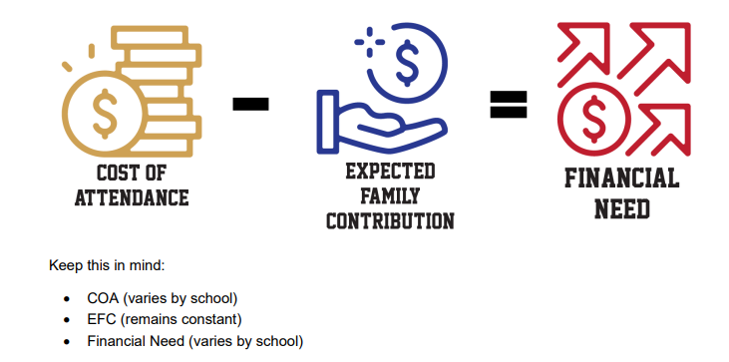
COST OF STUDENT AID OTHER FINANCIAL
ATTENDANCE (COA) INDEX (SAI) AID (OFA)
Tuition & Fees
Room & Board
Books & Supplies
Equipment
Transportation
Miscellaneous Personal
Expenses
Parent Contribution
Student Contribution
-
Keep this in mind:
COA (varies by school)
SAI (remains constant)
OFA (varies by school)

Slide 24
How do I apply?
l
l

Slide 25
Undocumented Circumstances
Parents without social security numbers will now be able to get an FSA ID electronically. Transunion knowledge-based questions will be used to verify identity, or documents may be provided to verify identity. Live language help is available for many different languages if you call the help center.
Please note: undocumented students (other than DACA) cannot complete a FAFSA because they do not have a social security number. Students under DACA can get a social security number, so they can complete a FAFSA, but those students are not eligible for federal or North Carolina government aid. They should check with their colleges to see if the FAFSA is the preferred form for receiving aid at the institution they will attend.

Slide 26
Information you’ll need to fill out the FAFSA:
Your social security number and driver’s license, and/or alien registration number
Student’s 2022 federal income tax returns, W-2s, and other records of money earned.
Parent’s 2022 income tax returns, W-2 forms and 1040 forms if you’re a dependent.
Bank statements and records of investments.
*The FAFSA will want information on available cash, balances in savings and checking accounts and any investment portfolios as of the date of the FAFSA.
*All real estate holdings other than the house you live in must be listed. The net work of Family farms and
small businesses are assets a a required part of the application
Child support counts as an asset.
The number of family members in college is no longer considered in the needs analysis formula, but it is still a required question on the FAFSA®form.

Slide 27
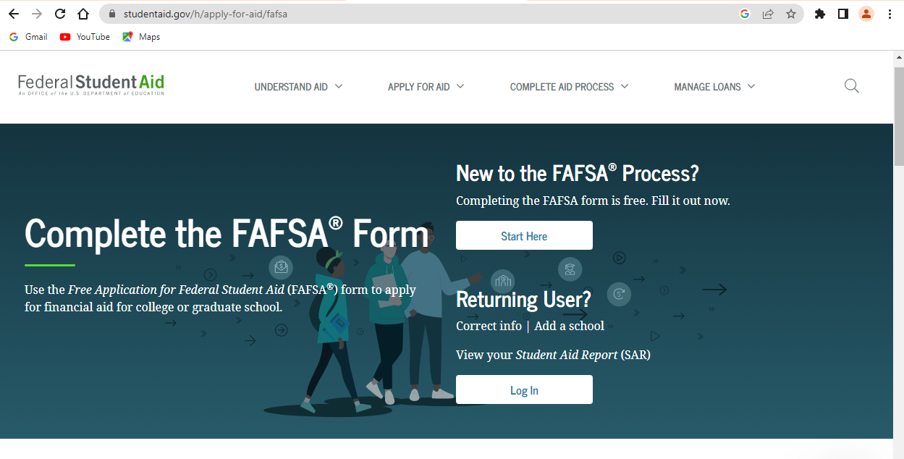
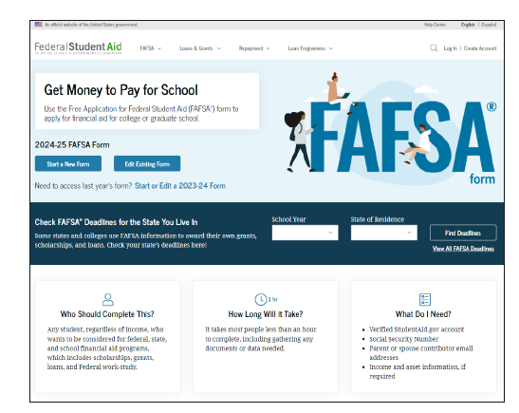
This is how the sign-in or landing page looks for students applying for financial aid for the second semester of this school year 2023-2024.
This is how the sign-in or landing page will look for students applying for financial aid for the 2024-2025 Fall and beyond semesters.

Slide 28
FAFSA
l
Year Entering Taxes
College
2023-2024 2021
Opened: October 2022
(Complete this form if
attending Spring 2024.)
2024-2025 2022
Open: December 2023
Complete this form if
attending Fall 2024
l

Slide 29
EARLY BIRD
Students who file the FAFSA during the first three months tend to receive double the grants, on average, of students who file the FAFSA later.
Source: 10 Financial Aid Myths: What you don’t know can cost you by Kathryn Flynn

Slide 30
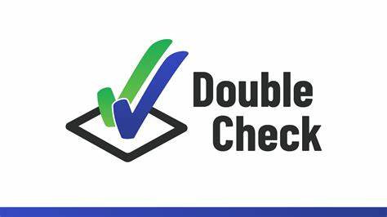
Before submitting your FAFSA, double check that all information is correct and no required information is missing.

Slide 31
COLLEGE SCHOLARSHIP SERVICE CSS Profile In North Carolina : Chapel Hill, Elon, Wake Forest, Duke, Davidson Costs $25 to submit and $16 for every submission afterward. Undergraduates coming from a family with an income under $100,000 may file for free.
OTHER FORMS YOU MAY HAVE TO COMPLETE
Institutional Documentation Service (IDOC) is a service that collects family financial documents and distributes them to institutions on behalf of the student. You'll be notified by the College Board if you need to submit documents through IDOC.
Some colleges have their own financial aid forms.
These forms must be filed according to the college’s deadlines.

Slide 32
Residency for tuition classification and State financial aid.

Slide 33
What happens next?

Slide 34
After submitting your FAFSA, check your email regularly and pay attention to any correspondence you receive from schools or the Department of Education itself requesting information.

Slide 35
View your
FSS
(FAFSA SUBMISSION SUMMARY)
This gives the student the opportunity to review the answers they submitted and correct any errors.

Slide 36
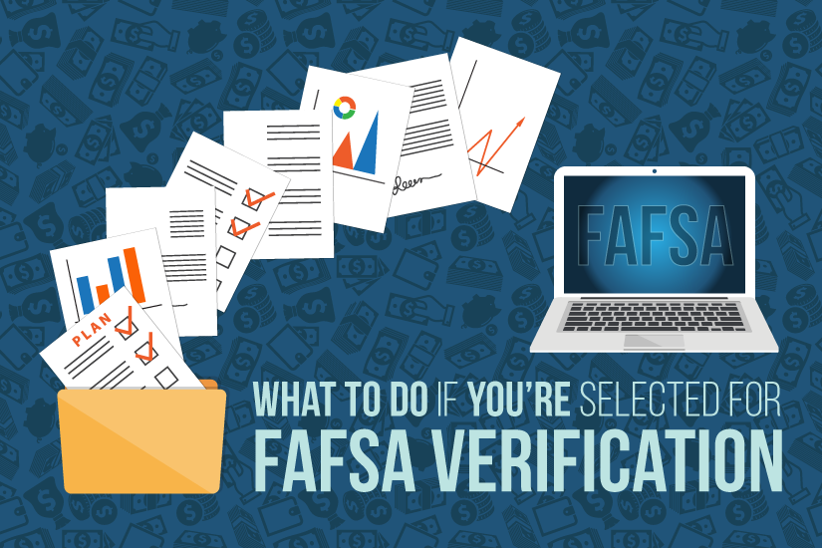
Verification is indicated by an asterisk next to a filer’s SAI or Student Aid Index on the FAFSA Submission Summary or FSS, which is sent out after the FAFSA is submitted.
Colleges then notify students – either through their online portals, personal email addresses, university email or by mail – about additional documentation needed. FAFSA filers are sometimes unaware they've been selected for verification, so it's important to regularly check those accounts.
If colleges find discrepancies between the actual tax documents that came in and what was on the FAFSA, they can make the corrections and update it. Then they can move on with processing the student's financial aid.
Selection for verification is random!
FAILURE TO RETURN THE VERIFICATION FORMS
BY THE DEADLINE WILL CAUSE YOU TO LOSE
THIS YEAR’S FINANCIAL AID.

